Slide 1
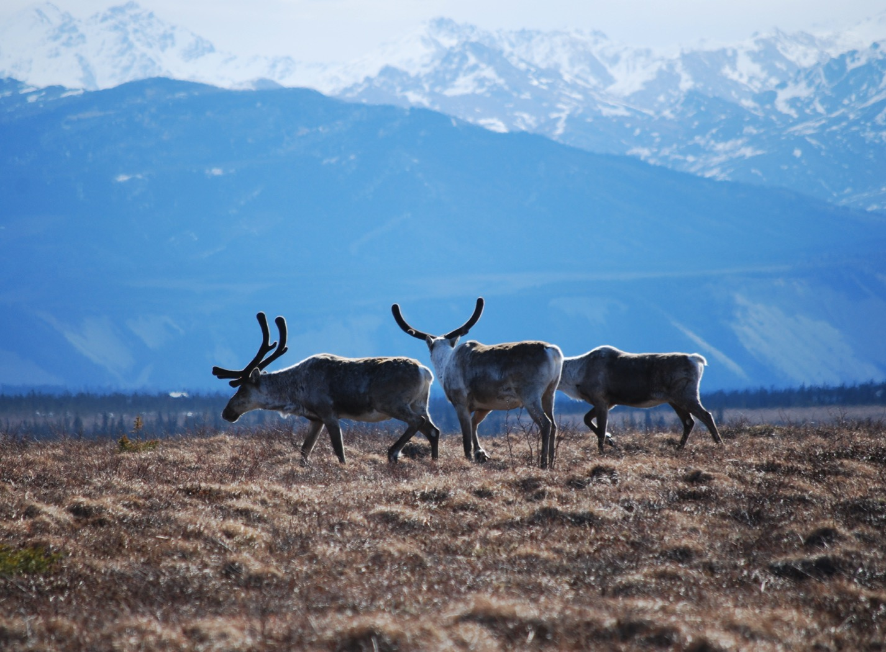
Arctic Boreal Vulnerability Experiment (ABoVE)
2017 ABoVE Airborne Campaign
20 July 2017 (DOY 201)
AVIRIS-NG: Yukon-Kuskokwim Delta
Charles Miller, Deputy Science Lead
Jet Propulsion Laboratory, California Institute of Technology
and the ABoVE Science Team For Hank Margolis, Eric Kasichke, Bruce Tagg
NASA HQ
2017

Slide 2
20 July 2017/DOY 201 Yukon-Kuskokwim Delta
Daily Status:
AVIRIS-NG / Dynamic Aviation B-200 (N53W)
REPORT DATE: 20 July 2017
Current Status of Aircraft: Yellow
Current Status of AVIRIS: GREEN
Current Deployment Location: Fairbanks AK (PAFA)
Crew: Rogers, Heidt, Nolte, Bernas
Science Coordinator: A Thorpe
Science Lead: C Miller
Project Managers: M Eastwood, I McCubbin
Instrument PI: R Green
Notes:
Aircraft avionics package continues to have intermittent loss of heading problems

Slide 3
20 July 2017/DOY 201 72-Hour Look Ahead
All plans weather dependent
Friday 21 July – Friday 28 July: Avionics repair @ Kenai
Hard down day
Saturday 29 July – Monday 31 July 2017:
Alaska Targets of Opportunity
Tuesday 1 August 2017 (DOY 213):
Transit to Canadian targets

Slide 4
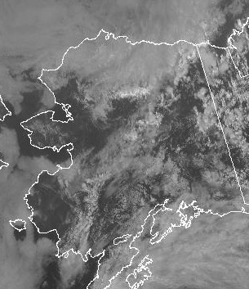
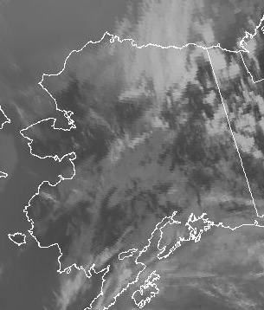
20 July 2017/DOY 201 Yukon-Kuskokwim Delta
GOES-West Vis 2200Z
GOES-West IR 2200Z
Notes:
Mostly clear across the interior of the YK Delta after morning fog dissipates. Some fog still persists along the coast

Slide 5
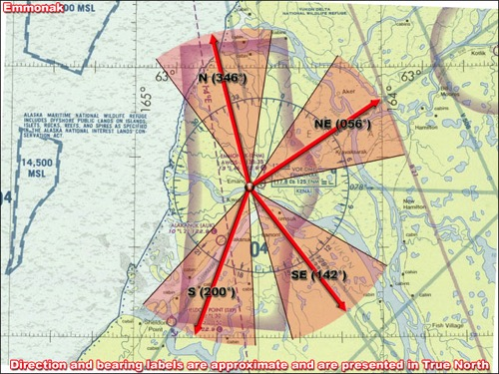
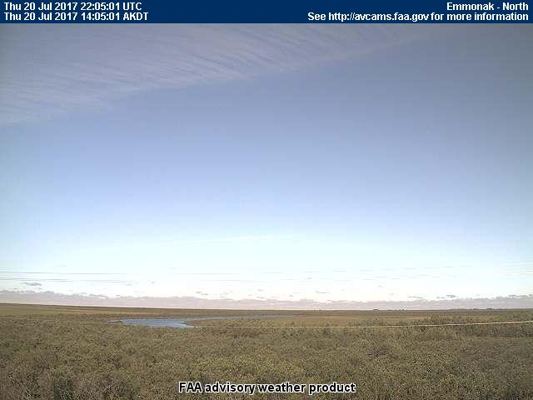
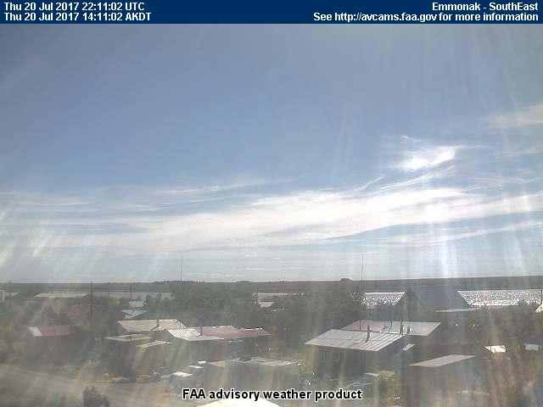
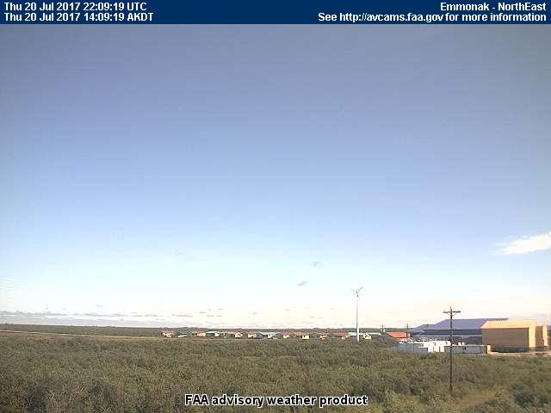
20 July 2017/DOY 201 Yukon-Kuskokwim Delta
Emmonak (ENM) (PAEM)
NORTH
North
South
Southeast
Northeast
Notes:
AVCAM sky pictures from the Emmonak near the Bering Sea coast showing mostly clear conditions with some high cirrus on the horizon – relevant for lines 1-4
See http://avcams.faa.gov/ for an interactive map of Alaska aviation cameras

Slide 6
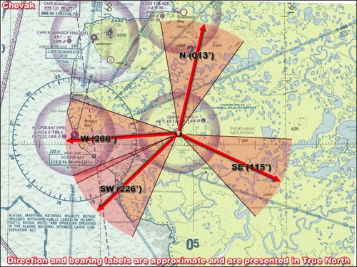
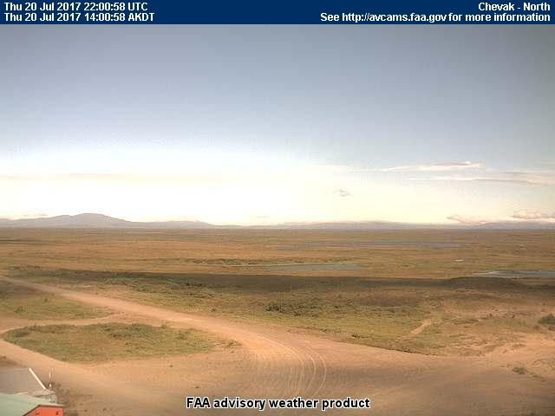
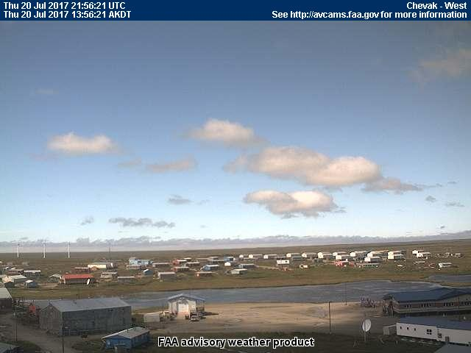
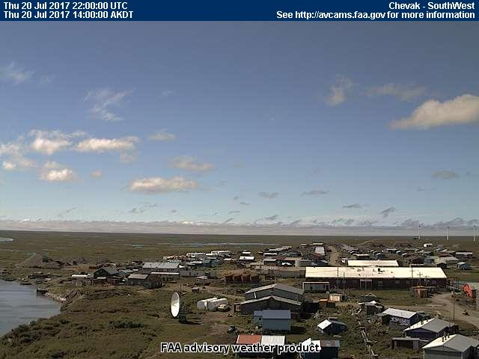
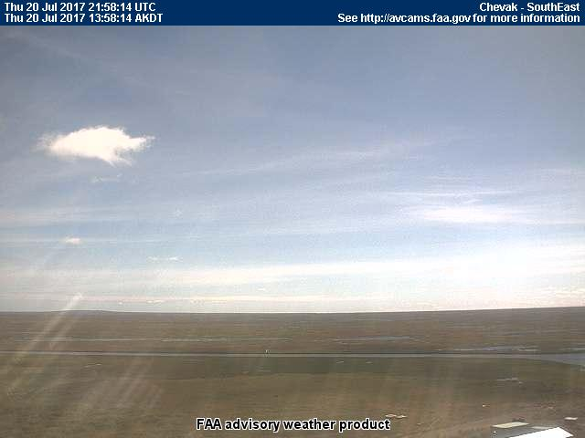
20 July 2017/DOY 201 Yukon-Kuskokwim Delta
Chevak (VAK)
NORTH
North
West
Southwest
Southeast
Notes:
AVCAM sky pictures from Chevak show mostly clear conditions with a few fair weather clouds; relevant for Lines 5-7
See http://avcams.faa.gov/ for an interactive map of Alaska aviation cameras

Slide 7
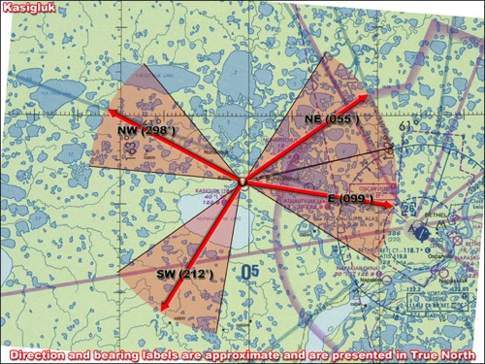
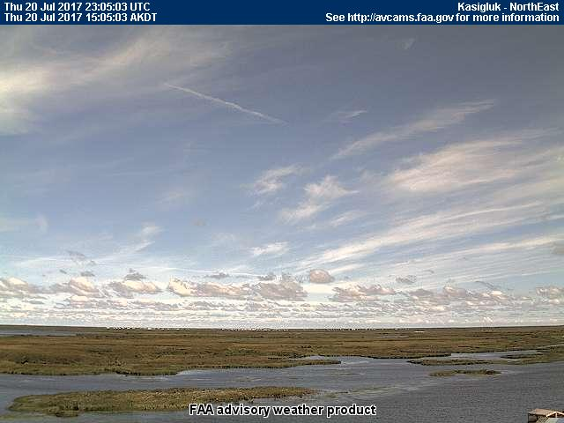
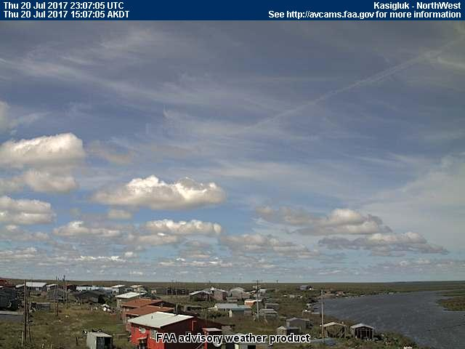
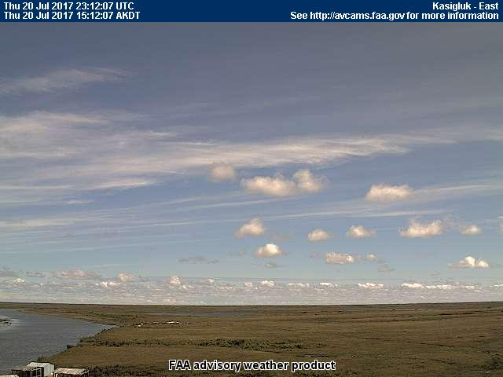
20 July 2017/DOY 201 Yukon-Kuskokwim Delta
Kasigluk (Z09) (PFKA)
NORTH
Northeast
West
Southwest
East
Notes:
AVCAM sky pictures from Kasigluk showing partly cloudy conditions with some high cirrus; relevant for Line 8
See http://avcams.faa.gov/ for an interactive map of Alaska aviation cameras

Slide 8
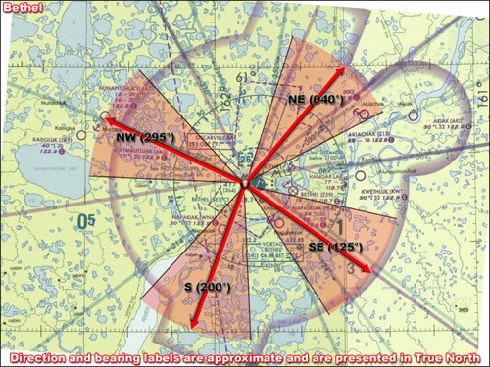
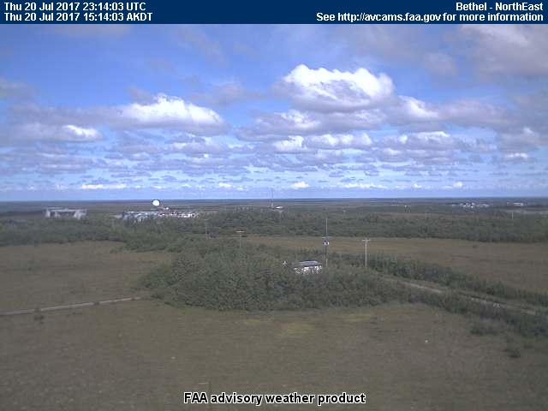
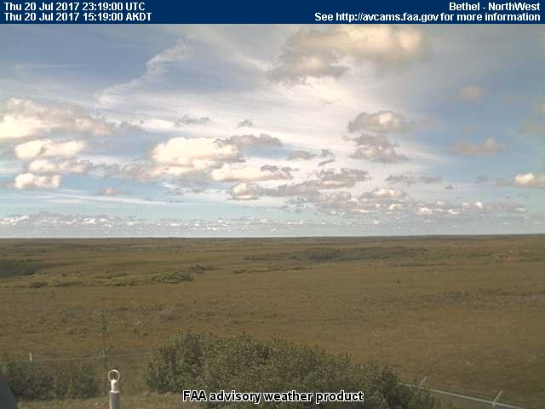
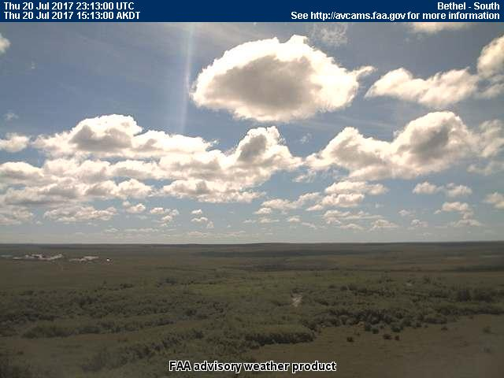
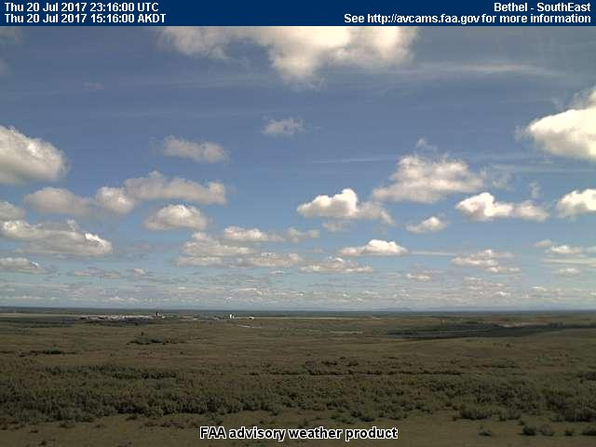
20 July 2017/DOY 201 Yukon-Kuskokwim Delta
Bethel (BET)
NORTH
Northeast
Northwest
South
Southeast
Notes:
AVCAM sky pictures from Bethel showing partly cloudy conditions; relevant to Line #8
See http://avcams.faa.gov/ for an interactive map of Alaska aviation cameras

Slide 9
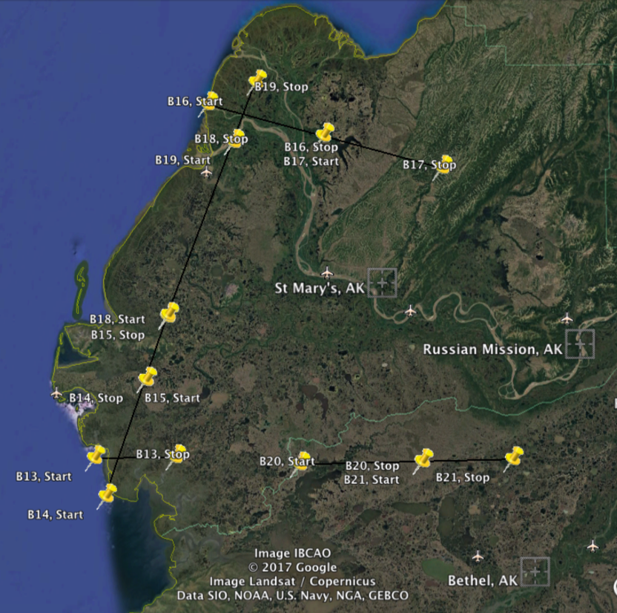
20 July 2017/DOY 201 Yukon-Kuskokwim Delta
Planned flight lines
YK Delta
3
2
Data Acquisitions:
Line 1, B17, Track Air #95
Line 2, B16, Track Air #94
Line 3, B19, Track Air #97
Line 4, B18, Track Air #96
Line 5, B15, Track Air #93
Line 6, B14, Track Air #94
Line 7, B13, Track Air #91
Line 8, B20, Track Air #98
Line 9, B21, Track Air #99
1
4
5
6
7
8
9
Notes:
Line 9, B20 successfully acquired on 7/7/17

Slide 10
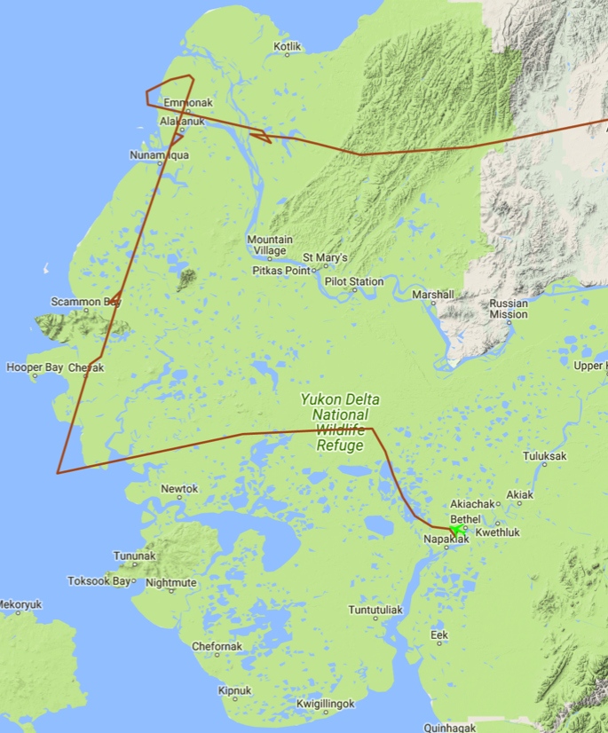
20 July 2017/DOY 201 Yukon-Kuskokwim Delta
Planned flight lines
As-flown Lines:
Sortie #1
Planned Lines:
Sortie #1
3
3
2
Data Acquisitions:
Line 1, B17
Line 2, B16
Line 3, B19
Line 4, B18
Line 5, B15
Line 6, B14
Line 7, B13
Line 8, B20
Line 9, B21
1
2
1
4
4
5
6
5
7
8
6
7
8
9
Notes:
Line #9 not flown – acquisition on 7/7/17 was sufficiently cloud-free

Slide 11
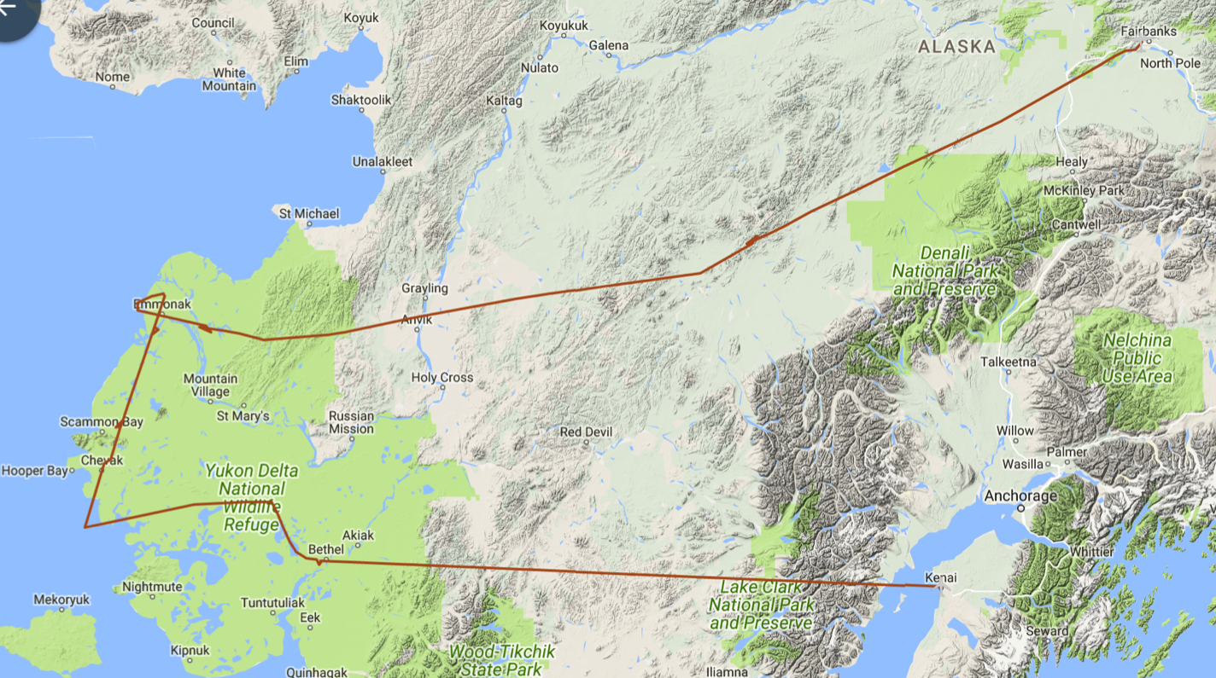
20 July 2017/DOY 201 Yukon-Kuskokwim Delta
As-flown flight lines & acquisition segments
B30
B29
B19
B16
B17
B18
B15
B14
B13
B20
Notes:
Excessive cloud cover in the Upper Kuskokwim Valley significantly interfered with acquisitions for lines B30 and B29

Slide 12
20 July 2017/DOY 201 Yukon-Kuskokwim Delta
AVIRIS-NG Quick-look products
https://avirisng.jpl.nasa.gov/cgi/flights.cgi?step=view_flightlog&flight_id=ang20170720t
A. Line B30, Track Air #108, Run ID 195552: Kuskokwim River - Nikolai-Telida
B. Line B29, Track Air #107, Run ID 200841: Kuskokwim River - McGrath-Nikolai
Winston Olson-Duvall, JPL
A
B
A & B. Excessive cloud cover in the Upper Kuskokwim Valley renders lines B30 and B29 unusable

Slide 13
20 July 2017/DOY 201 Yukon-Kuskokwim Delta
AVIRIS-NG Quick-look products
https://avirisng.jpl.nasa.gov/cgi/flights.cgi?step=view_flightlog&flight_id=ang20170720t
A. Line B17, Track Air #95, Run ID 210910: Mouth of Yukon R - inland transect - cont of B16
B. Line B16, Track Air #94, Run ID 212431: Mouth of Yukon R - inland transect
Winston Olson-Duvall, JPL
A
B
Emmonak
A. Inland acquisition east of Emmonak
B. Coastal clouds (left hand edge) obscure the main channel of the Yukon River emptying into the Bering Sea at Emmonak

Slide 14
20 July 2017/DOY 201 Yukon-Kuskokwim Delta
AVIRIS-NG Quick-look products
https://avirisng.jpl.nasa.gov/cgi/flights.cgi?step=view_flightlog&flight_id=ang20170720t
A. Line B19, Track Air #97, Run ID 214520: YK Delta transect - continuation of B18
B. Line B18, Track Air #96, Run ID 215547: YK Delta transect - continuation of B15
Winston Olson-Duvall, JPL
A
B
A. Small “popcorn” clouds in this scene
B. Increasing cloud cover encountered towards the southern end of Line B18

Slide 15
20 July 2017/DOY 201 Yukon-Kuskokwim Delta
AVIRIS-NG Quick-look products
https://avirisng.jpl.nasa.gov/cgi/flights.cgi?step=view_flightlog&flight_id=ang20170720t
A. Line B15, Track Air #93, Run ID 221509: YK Delta transect - continuation of B14
B. Line B14, Track Air #94, Run ID 222512: Frost - YK Delta parallel coast
Winston Olson-Duvall, JPL
A
B
A & B. Cloud field seen at the connecting edges of lines B14 and B13

Slide 16
20 July 2017/DOY 201 Yukon-Kuskokwim Delta
AVIRIS-NG Quick-look products
https://avirisng.jpl.nasa.gov/cgi/flights.cgi?step=view_flightlog&flight_id=ang20170720t
A. Line B13, Track Air #91, Run ID 224114: Frost - YK Delta coast - inland transect
B. Line B20, Track Air #98, Run ID 225802: Schaefer - YK Delta lakes
Winston Olson-Duvall, JPL
A
B
A. Clouds interfere with the right hand side of line B13
B. Patchy clouds obscure the beginning of this otherwise excellent acquisition

Slide 17
20 July 2017/DOY 201 Yukon-Kuskokwim Delta
Notes:
Top: Emmonak as recorded in Line B16, Track Air #94, Run ID 212431
Bottom: Wetlands detail from Line B20, Track Air #98, Run ID 225802 showing unusual greenness

Slide 18
Backup

Slide 19
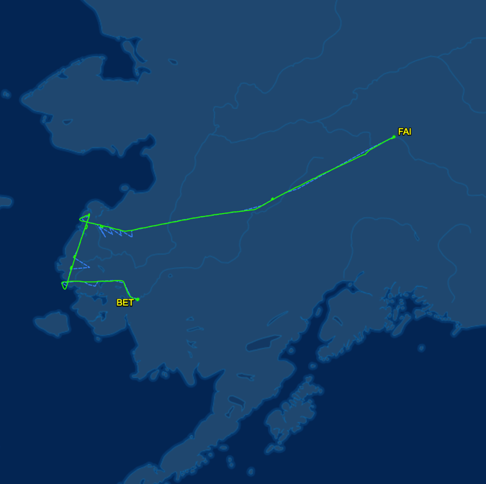
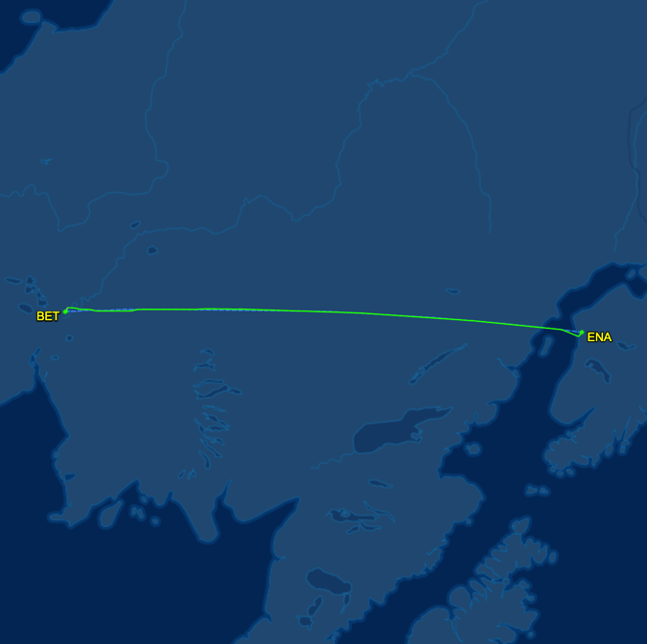
20 July 2017/DOY 201 Yukon-Kuskokwim Delta
As-flown Lines: Sortie #1
As-flown Lines: Sortie #2
Sortie #1. Data acquisition in the Yukon-Kuskokwim Delta
Sortie #2. Transit form Bethel to Kenai

Slide 20
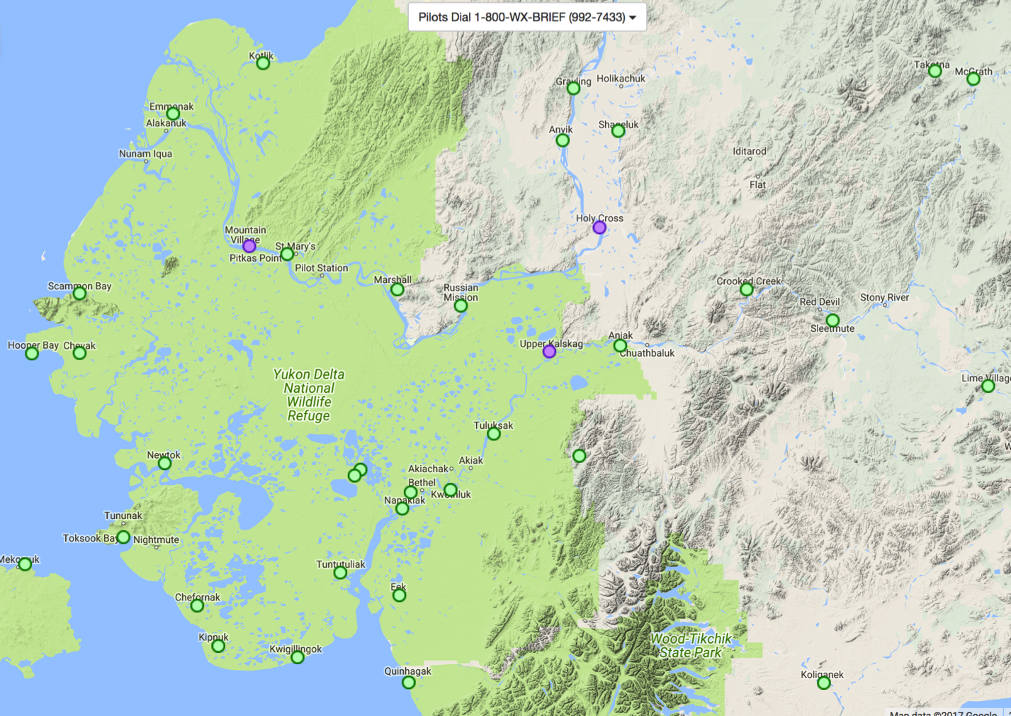
7 July 2017/DOY 188 Yukon-Kuskokwim Delta
FAA AVCAMS in the
YK Delta & Surrounding Areas

Slide 21
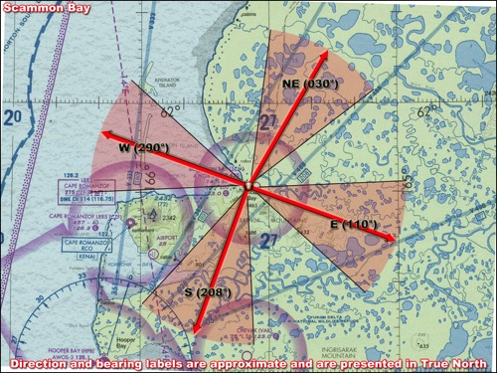
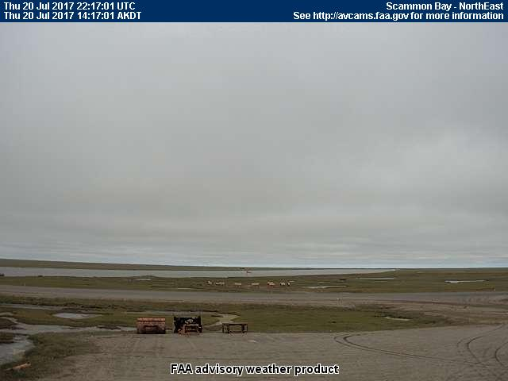
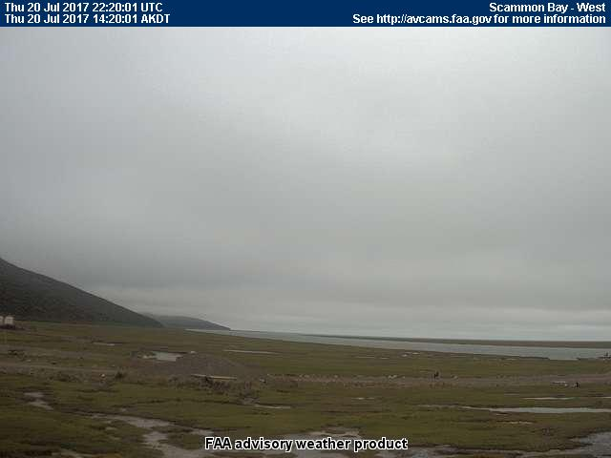
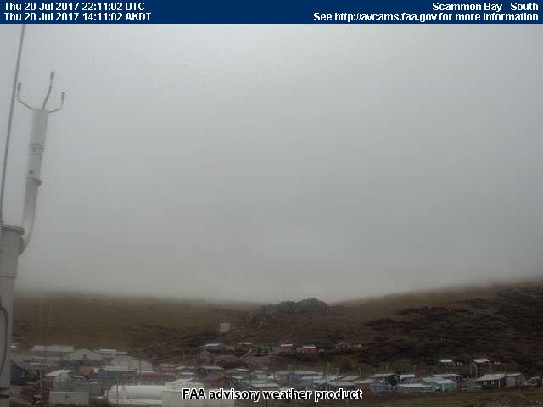
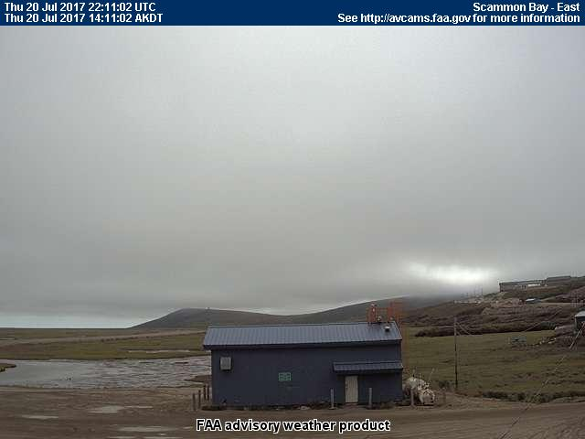
20 July 2017/DOY 201 Yukon-Kuskokwim Delta
Scammon Bay (SCM)
NORTH
North
West
South
East
Notes:
AVCAM sky pictures Scammon Bay at 1420 AKDT/2220 UTC showing fog and low clouds despite clear skies at Chevak
See http://avcams.faa.gov/ for an interactive map of Alaska aviation cameras

Slide 22
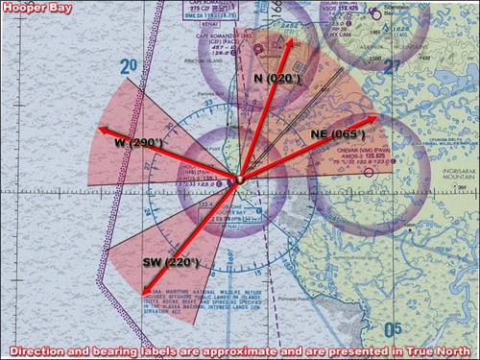
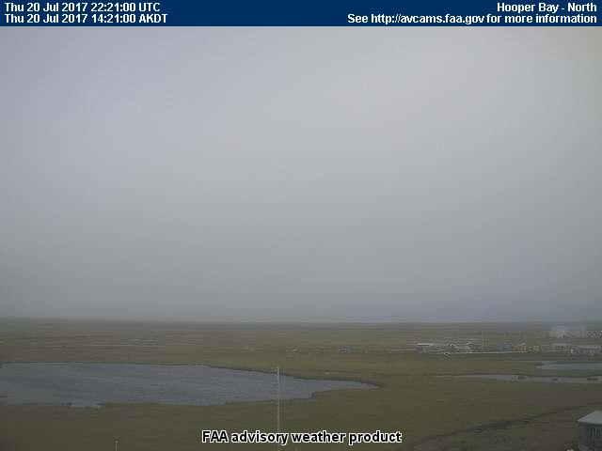
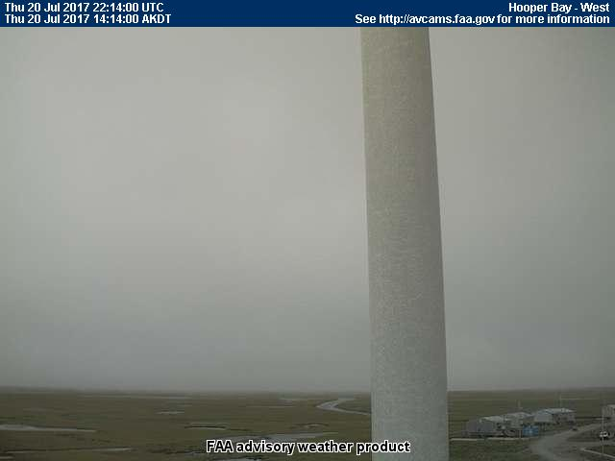
20 July 2017/DOY 201 Yukon-Kuskokwim Delta
Hooper Bay (HPB)
NORTH
North
West
Southwest
Northeast
Notes:
AVCAM sky pictures from Hooper Bay (near Chevak) at 1420 AKDT/2220 UTC showing fog and low clouds despite clear skies at Chevak
See http://avcams.faa.gov/ for an interactive map of Alaska aviation cameras

Slide 23
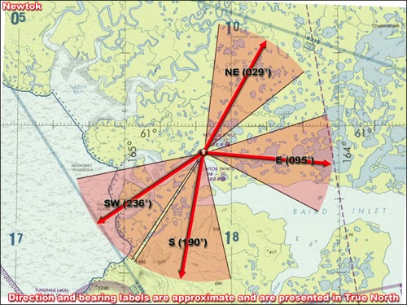
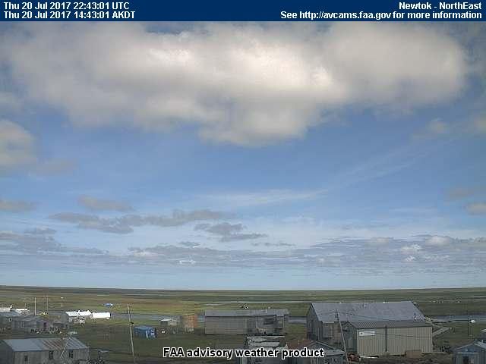
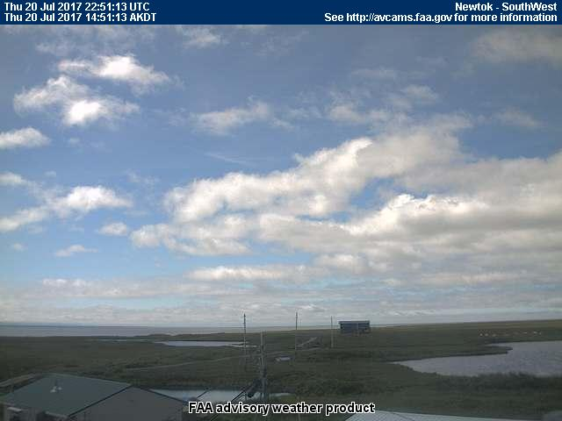
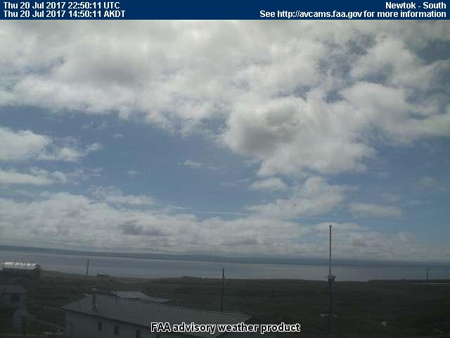
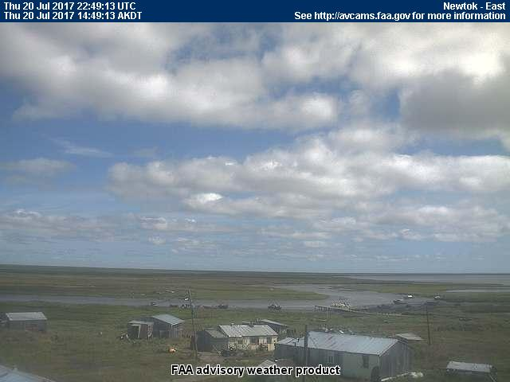
20 July 2017/DOY 201 Yukon-Kuskokwim Delta
Newtok (EWU)
NORTH
Northeast
Southwest
South
East
Notes:
AVCAM sky pictures from Hooper Bay (near Chevak) at 1420 AKDT/2220 UTC showing fog and low clouds despite clear skies at Chevak
See http://avcams.faa.gov/ for an interactive map of Alaska aviation cameras

